Slide 1
BRIGHTBORN
Zeynep Övgü YAYCI
Uğur DURA
Cem ÖZCAN
Mustafa AYKAÇ
Burak ERDOĞAN

Slide 2
Content
1.Overview
2.High-Level Functionality
3.Stakeholders
4.Project Staffing
5.Software Process Model
6.Schedule and Effort
7.Measurements
8.Project Risks
9.Software Tools
10.Project Needs

Slide 3
Intoduction
We are living in a globalized world, and as a result of this, there is an increase in the number of inter-race couples. Thus, the gene combinations that cause genetical diseases also increased. Since it is a long process to find treatment for genetic diseases, we are aiming to prevent them from begining. In order to do that we combined software technology and genetical knowledge together to create an algorithm to find the possibility of these genetical diseases.

Slide 4
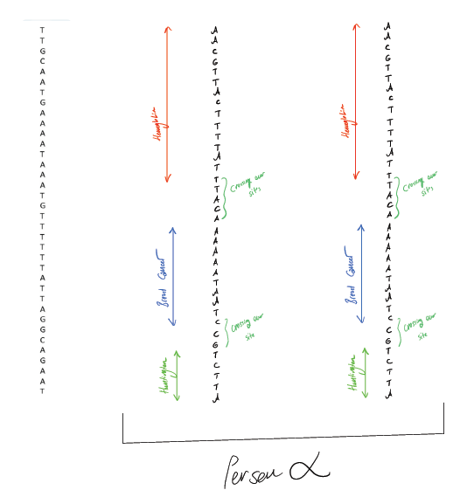

Slide 5
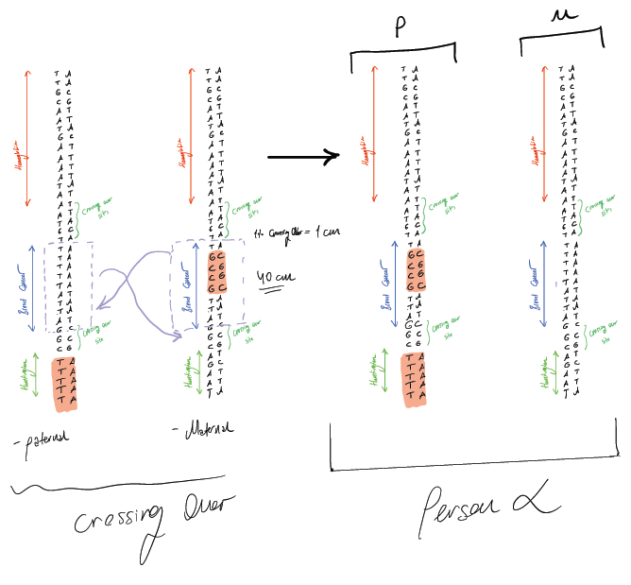

Slide 6
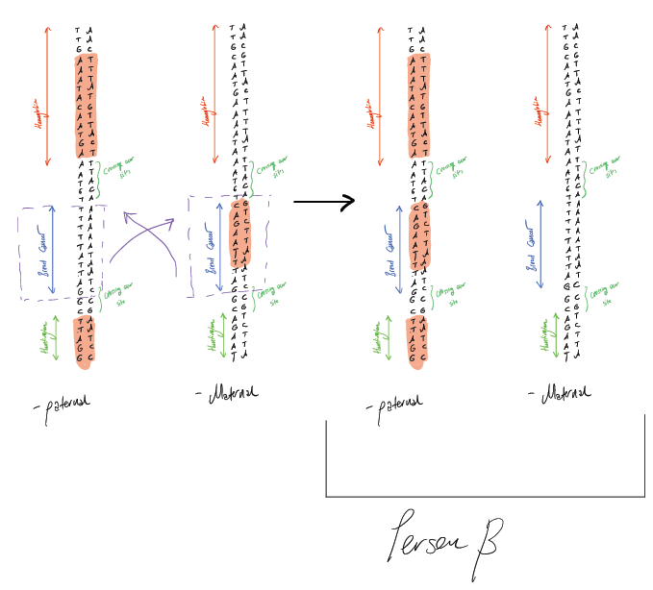

Slide 7
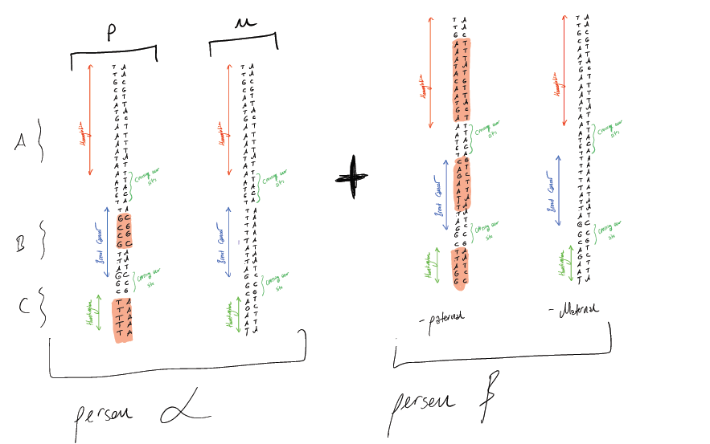

Slide 8
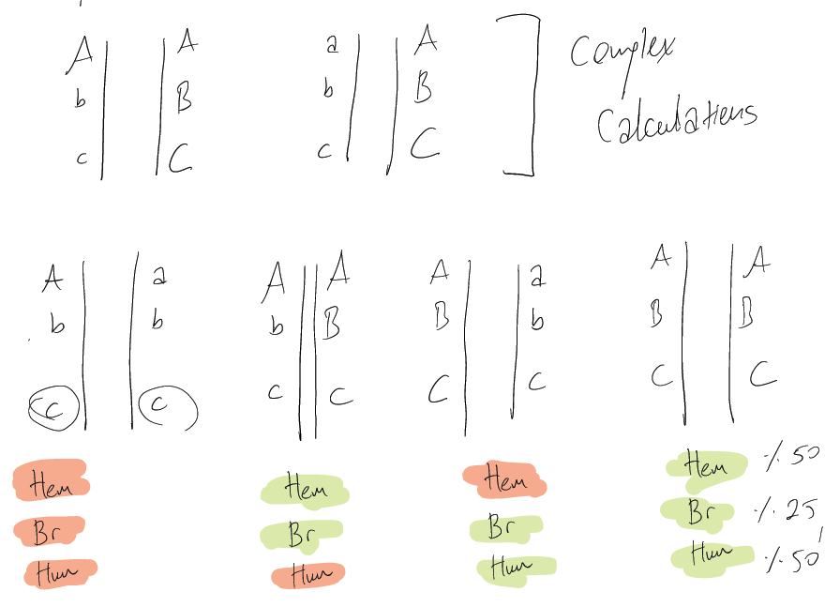

Slide 9
Objectives
Generating synthetic genomes
Taking genetic information from partners
Checking the similarities between participants genome and ex clinical results
Determining mutations in participants genome
Simulating crossing over
Creating possible offsprings of both participants
Giving the possibility of participants’ children having a genetical disease

Slide 10
Functional Requirements
Possible offspring report
Reporting in advance
Clinical data updating

Slide 11
Non-Functional Requirements
Optimized
Database Accessibility
Security
Multi-user software
User-friendly

Slide 12
Stakeholders
Patients
Doctors
Researchers
QIAGEN
Hospital
Staff

Slide 13
PROJECT STAFFING
Software Project Manager: Zeynep Ovgu YAYCI
Requirements Engineer: Ugur DURA
Lead Designer: Burak ERDOGAN
Tester: Mustafa AYKAC
Project Developer: Cem OZCAN

Slide 14
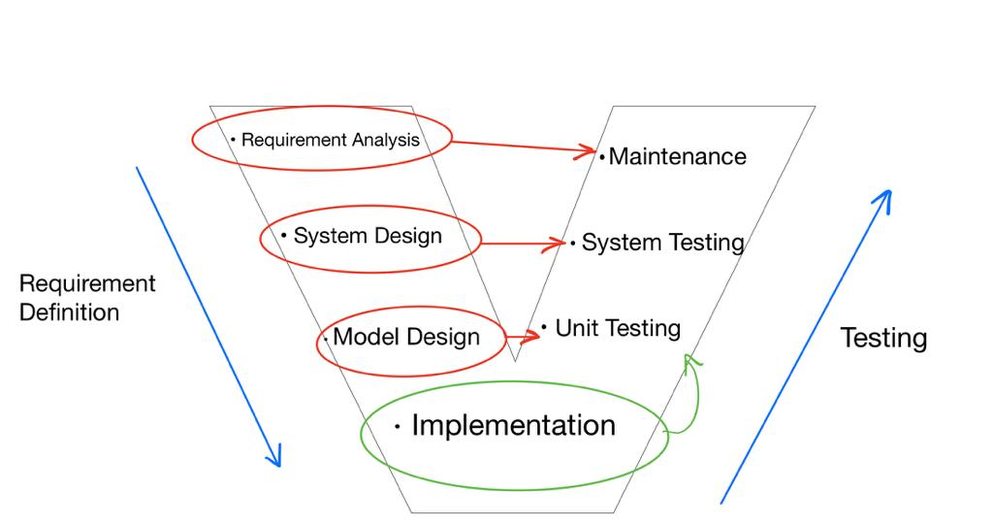
Software Process Model: V Model

Slide 15
The Reason To Choose This Model
The project requirements are clear
Since the program is health related, each stage needs to be carefully designed and tested
Our project is a medium sized project, so the V model is appropriate
Since our projects has a dynamic database, after all the stages are finished; maintenance needs to be continuous
Since our project has a high-risk potential; this model will work better than some other models
In our project technical resources that we need are already available

Slide 16
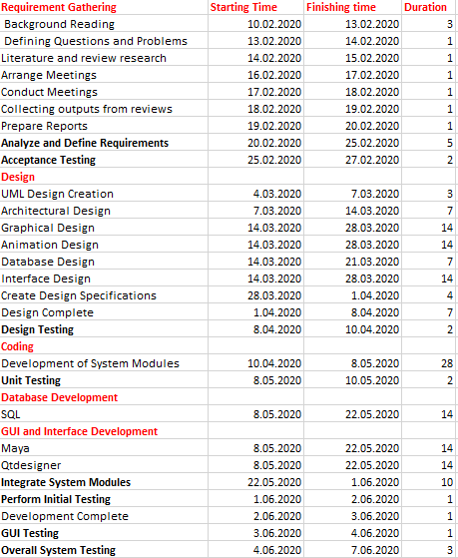
SCHEDULE AND EFFORT

Slide 17
Gantt Chart

Slide 18

MEASUREMENTS
Dataset Storage
Data Collection
Performance and Evaluation
Response Time
Code Size Measurement
Effort Distribution

Slide 19

Project Risks
Complex Calculations
Hardware Limitation
Data Accessibility
Tools
Training
UI Complexity
Debugging

Slide 20
LIKELIHOOD RANK | IMPACT RANK | COMBINED RANK | RISK DESCRIPTION
3 | 1 | 4 | Complex Calculations – according to accuracy of reports; complex possibility calculations lead software to generate weak spots
2 | 2 | 4 | Hardware Limitation – During the computations for marking mutant genes and possible outcome, virtual space might not be enough for certain computations. It should be tested and optimized on every step.
1 | 7 | 8 | Data Accessibility – If the companies holding the data required for comparison with other genes restrict access to this data, we may not be able to obtain sufficient data thats why we need to search for alternatives.
4 | 5 | 9 | Tools – The team needs to learn new tools to support the project otherwise the required sofware tools can be formed according to the team members skills.
6 | 3 | 9 | Training – We have limited time to finish this project; so the team members should train in a short period of time.
7 | 4 | 11 | UI Complexity – User interface should not create any dilemma thus it should be clear to understand by users.
5 | 6 | 11 | Debugging – Due to the complex calculations required ort he project. Any of the errors can make debugging hard for the team.

Slide 21
Software Tools

Slide 22
Software Tools

Slide 23
Software Tools

Slide 24
Software Needs
SQL Server
Operating System
Modo
QtDesigner
Office 365

Slide 25
Hardware Needs
Display Screen: Used to see the results
Disk Space: To store our genetical information
Display Card: To take inputs and process 3D data efficiently
Processor: To compute mathematical calculations

Slide 26
Support Needs:
Genetical Information : The data we need to get from other databases
Genetical Knowledge: While we are designing algorithms for possible breadings we need to construct according to this knowledge
Mathematical Knowledge: We need to implement possibility calculations in order to reach a result.
Clinical Results: We can get these data with using ex-clinical research reviews to increase accuracy

Slide 27
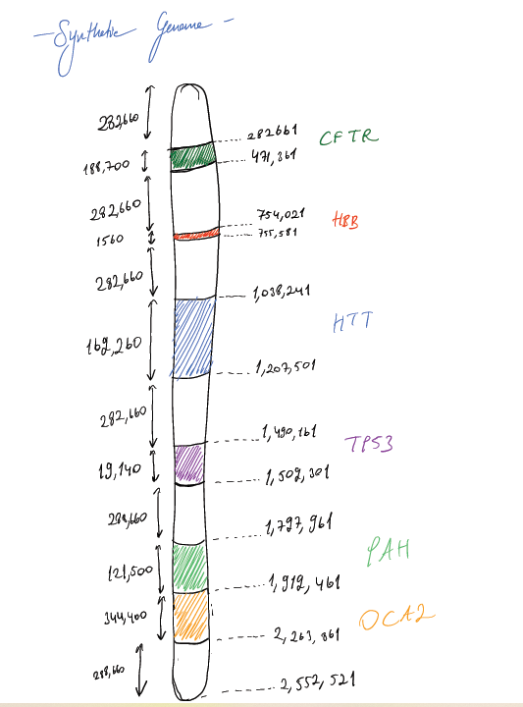
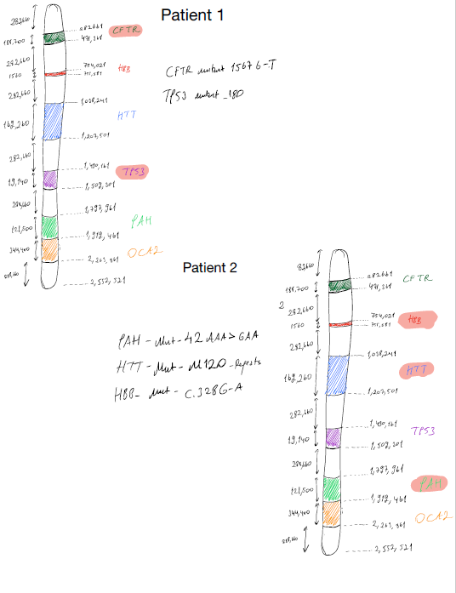

Slide 28
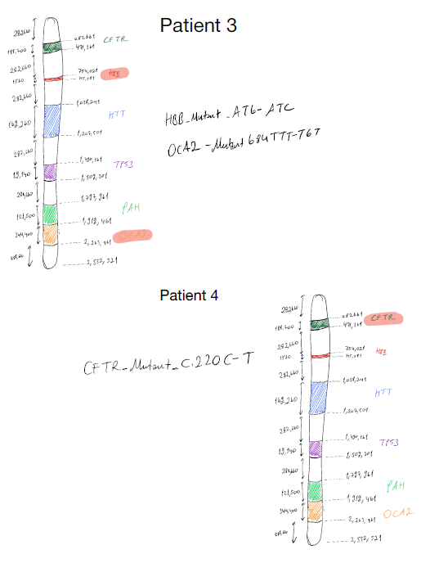


Slide 29
Thank you for listening!

